Slide 1

创新科技
爱上电子积木Arduino
第四课 矩阵按键控制
2015.12.12

Slide 2

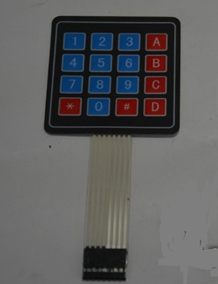
矩阵按键控制
这里简单介绍一种矩阵键盘的工作原理，4*4矩阵键盘有8个引脚，4个一组，分别对应行和列，通过按键扫描的方法，对不同行（列）分别输入高低电平，然后读取不同列（行）上的电平，从而知道键盘上的某一按键按下。
例如，当第1行输出低电平，其他行输出高电平，分别读取依次列上的状态，如果第1列为低，结果为（1,1），按键为1，如果第2列为低，则结果为（1,2）按键为2。
矩阵按键

Slide 3
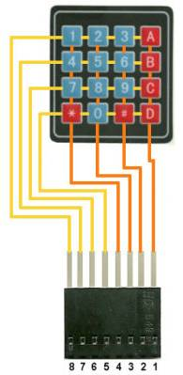
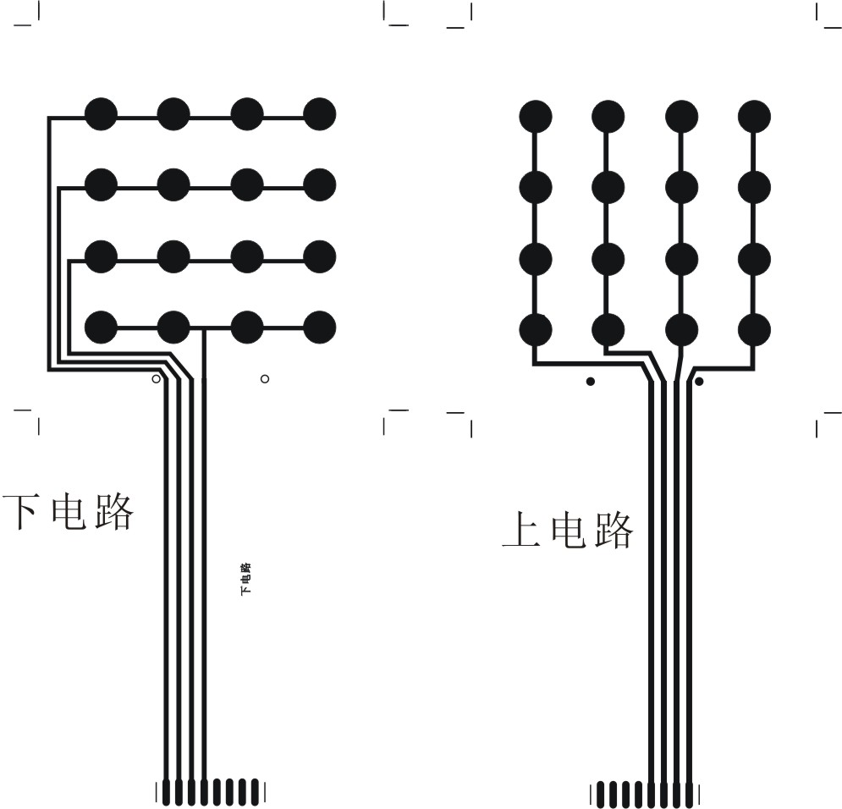
矩阵按键控制

Slide 4
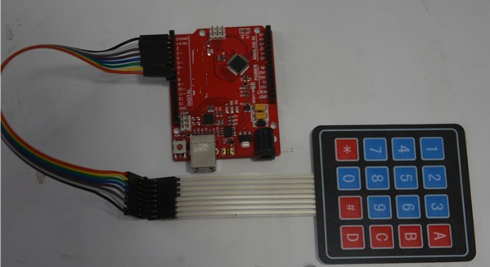
电路
开始搭建我们的电路，下面是电路图：
实验要求
通过串口将按键的键号发给上位机并显示。
硬件连接
Arduino 9接第一行（左一）
Arduino 8接第二行（左二）
Arduino 7接第三行（左三）
Arduino 6接第四行（左四）
Arduino 5接第一列（左五）
Arduino 4接第二列（左六）
Arduino 3接第三列（左七）
Arduino 2接第四列（左八）

Slide 5
程序(无库函数)
unsigned char row[] = {9,8,7,6};
unsigned char col[] = {5,4,3,2};
char a[4][4] = { { '1','2','3','A' }, {'4','5','6','B' }, {'7','8','9','C' }, {'*','0','#','D' }
};
void setup() {
Serial.begin(9600);
for(int i=0;i<4;i++)
{
pinMode(row[i],OUTPUT);
}
for(int i=0;i<4;i++)
{
pinMode(col[i],INPUT);
}

Slide 6
程序(无库函数)
for(int i=0;i<4;i++)
{
digitalWrite(row[i],HIGH);
}
for(int i=0;i<4;i++)
{
digitalWrite(col[i],HIGH);
}
}

Slide 7
程序(无库函数)
void loop() {
char keyvalue;
char flag =0;
for(int i=0;i<4;i++)
{ digitalWrite(row[i],LOW);
for(int j=0;j<4;j++) {
if(digitalRead(col[j])==LOW)
{ delay(15);
while(digitalRead(col[j])==LOW);
keyvalue = a[i][j];flag =1;
}
}
digitalWrite(row[i],HIGH);
}
}

Slide 8
程序(无库函数)
if(flag !=0){
Serial.print("Got key ");//串口打印键值
Serial.print(keyvalue);
}

Slide 9
程序(库函数)
#include <Keypad.h>
const byte ROWS = 4; //four rows
const byte COLS = 4; //four columns
//define the cymbols on the buttons of the keypads
char hexaKeys[ROWS][COLS] = {
{'1','2','3','A'},
{'4','5','6','B'},
{'7','8','9','C'},
{'*','0','#','D'}
};
byte rowPins[ROWS] = {9, 8, 7, 6}; //connect to the row pinouts of the keypad
byte colPins[COLS] = {5, 4, 3, 2}; //connect to the column pinouts of the keypad
//initialize an instance of class NewKeypad
Keypad customKeypad = Keypad( makeKeymap(hexaKeys), rowPins, colPins, ROWS, COLS);

Slide 10
程序(库函数)
void setup(){
Serial.begin(9600);
}
void loop(){
char customKey = customKeypad.getKey();
if (customKey){
Serial.println(customKey);
}
}

Slide 11
函数
void begin(makeKeymap(userKeymap))
Initializes the internal keymap to be equal to userKeymap
[See File -> Examples -> Keypad -> Examples -> CustomKeypad]
char waitForKey()
This function will wait forever until someone presses a key. Warning: It blocks all other code until a key is pressed. That means no blinking LED's, no LCD screen updates, no nothing with the exception of interrupt routines.
char getKey()
Returns the key that is pressed, if any. This function is non-blocking.
KeyState getState()
Returns the current state of any of the keys.
The four states are IDLE, PRESSED, RELEASED and HOLD.

Slide 12
函数
boolean keyStateChanged()
New in version 2.0: Let's you know when the key has changed from one state to another. For example, instead of just testing for a valid key you can test for when a key was pressed.
setHoldTime(unsigned int time)
Set the amount of milliseconds the user will have to hold a button until the HOLD state is triggered.
setDebounceTime(unsigned int time)
Set the amount of milliseconds the keypad will wait until it accepts a new keypress/keyEvent. This is the "time delay" debounce method.
addEventListener(keypadEvent)
Trigger an event if the keypad is used. You can load an example in the Arduino IDE.
[See File -> Examples -> Keypad -> Examples -> EventSerialKeypad] or see theKeypadEvent Example code.

Slide 13
函数
使用Arduino Keypad键盘库注意事项
该键盘库是属于无阻塞式，按下谋键不放，其余（接下来）的代码还是会继续运行
如果编写控制键盘处运用到delay()，这将造成键盘反应迟顿
按下谋键，getKey()只返回一个键值，而不是自动重复。松开按键时，可以追踪其RELEASED event

Slide 14
感谢您的关注

